Slide 1

Big Mountain Resort Pricing and Facilities Optimization

Slide 2
Problem Identification
Original Problem Statement: Increase Big Mountain Resort's net profit by 13% within the next ski season by implementing a data-driven ticket pricing strategy, based on a comparative analysis of the resort's facilities with competing resorts in the same market segment.
Big Mountain Resort is facing $1.54m of increased operating costs due to the installation of a new chair lift this season. The resort's current pricing strategy is based on charging a premium above the market average. However, we sense this approach may not be maximizing the revenue potential.
Options to consider: closing runs, adjusting ticket prices, or making facility improvements.

Slide 3
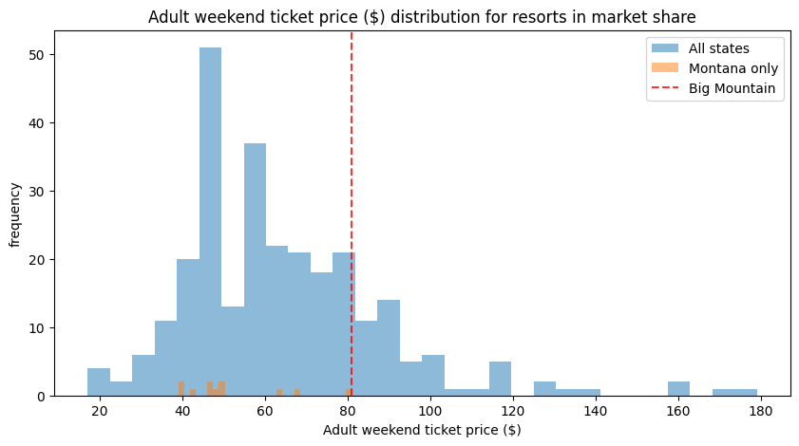
Recommendation and Key Findings
Big Mountain Resort's current ticket price of $81.00 is lower than the predicted price of $95.87 based on the resort's facilities.
Room for increasing the ticket price, which should result in higher revenue.
Big Mountain has several facilities that rank well in comparison to its competitors. These features contribute to the Resort´s ability to support a higher ticket price.

Slide 4
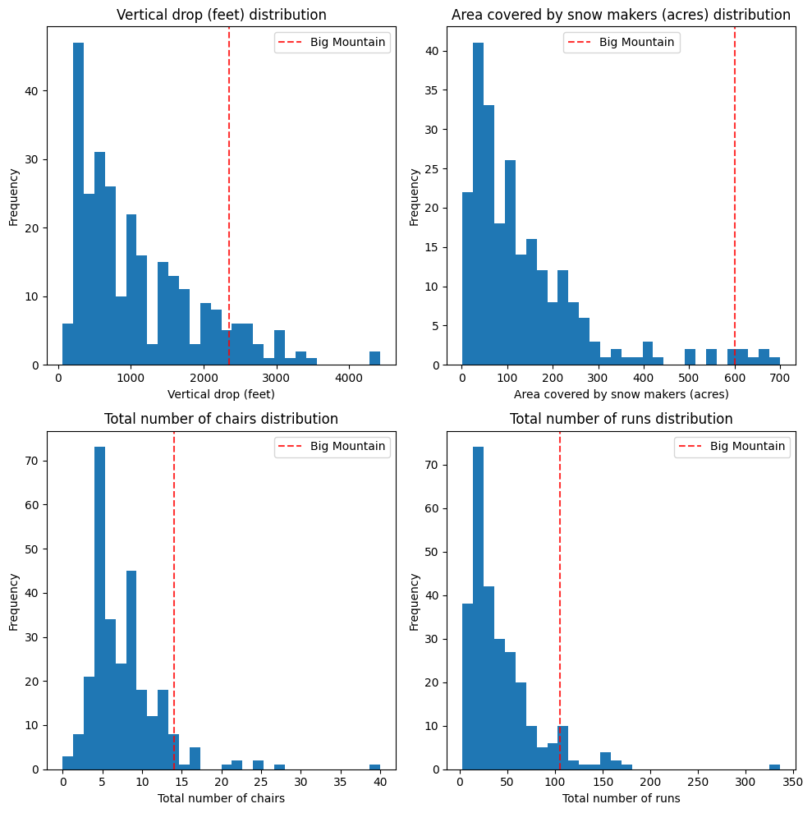
Ticket Pricing and Facility Comparisons
Ticket price is heavily impacted by these primary features
Here is a comparison of Big Mountain´s most relevant features for our analysis: vertical drop, snow-making area, total chairs, and number of runs to other resorts in the market

Slide 5
Recommendation and Key Findings
Implement Scenario 2: Increase the vertical drop by adding a run to a point 150 feet lower down, requiring the installation of an additional chair lift.
Result: Additional net revenue of $1,934,638 with a $1.99 ticket price increase per visitor.
Consider temporary closure of the least popular runs for cost reduction if needed
The Resort should consider closing 4 or 5 runs.
Potential ticket price reduction: $1.26
Estimated revenue decline: $2,206,521
To make an informed decision on run closures, the resort should:
Conduct surveys or gather feedback from visitors to understand the impact of the closures on their experience.
Analyse historical usage data to identify the least popular or least profitable runs.
Implement temporary closures to evaluate the impact on visitor satisfaction, resort operations, and overall revenue.

Slide 6
Data and Modelling Approach
Two Models: Developed a Linear Regression model and a Random Forest model to predict ticket prices based on resort features.
Performance Evaluation: Evaluated both models' performance using 5-fold cross-validation and calculated the negative mean absolute error (MAE) for each fold:
Linear regression: cross-validated mean MAE = 10.499, test dataset MAE = 11.793.
Random forest: cross-validated mean MAE = 9.645, test dataset MAE = 9.538.
Model Selection: The random forest model outperformed the linear model, with lower MAE both in cross-validation (mean MAE = 9.645, std = 1.353) and on the test dataset (MAE = 9.538).

Slide 7
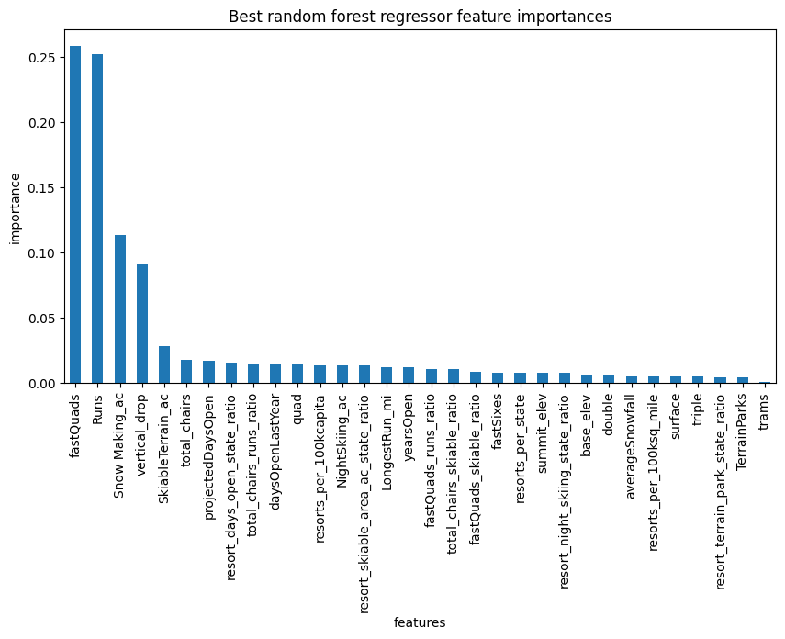
Modelling Results - Feature Importance
Top Four Features: The most influential features affecting ticket pricing are fastQuads, Runs, Snow Making_ac, and vertical_drop. These factors should be considered when making strategic decisions about the resort's offerings.
On average, the best random forest model explains around 70.97% of the variance in the target variable
Improved accuracy and addressed overfitting
GridSearchCV for optimal hyperparameters
R2= 0.7097, std= 0.0645

Slide 8
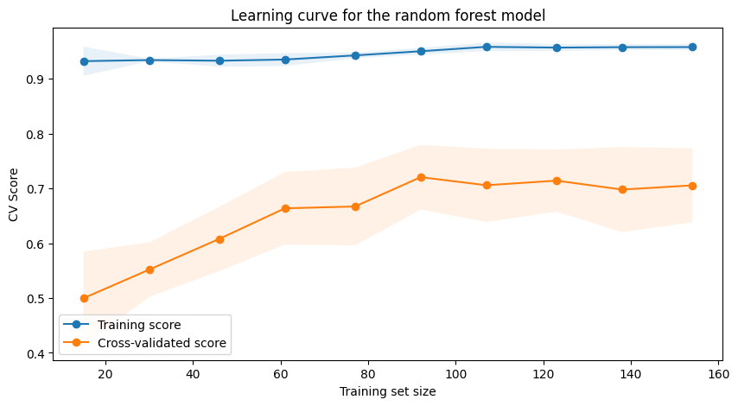
Modelling Results - Learning Curve
From the learning curve plot we can observe a rapid initial improvement in the model scores, levelling off at a sample size of around 40-50.
Shaded areas show score variability (± 1 std) indicating stable performance.
The model stabilizes as the training set size increases, suggesting that we have enough data to train a reliable model.

Slide 9
Summary and Conclusion
Recommendation Recap: Our analysis strongly supports the implementation of Option 2, which involves increasing the vertical drop by adding a run to a point 150 feet lower down and adding a new chairlift.
Financial and Visitor Experience Impact: This strategic change is projected to generate an additional net revenue of $1,934,638, significantly improving the resort's financial performance and improving visitor experience by offering more diverse run options and reducing lift wait times.
Emphasize Data-Driven Decisions: Adopting a data-driven pricing strategy enables Big Mountain Resort can make informed decisions about potential changes to their resort offerings and pricing strategy to grow its business.
The model could easily be deployed as a user-friendly interface to help management explore the potential outcomes of various scenarios.

